Slide 1
Onyx

Slide 2

Meet Joe…
Notes:
So, we’re starting off the next set of slides by doing some role playing
I’m going to ask you to put on Joe’s shoes.
Who is Joe? Joe is a bank teller / customer services guru working at ASB.
You interact and help clients out on a daily basis.
You
Open loans,
Check facts
Get quotes
Check Rates
Push envelopes,
Collaborate with colleagues over client’s information
And the list goes on and on.

Slide 3
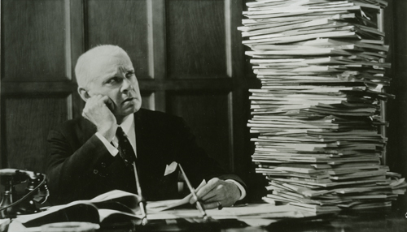
Frustration
Notes:
Imagine you had to do all that work, manually, the old fashioned way
Can you imagine the frustration both yours and the client you’re facing?
So much tedious work so many hours laboring over your desk till 1 in the morning.

Slide 4

Notes:
We all know the answer to every bank teller’s daily conundrum.
And that is a software package which can handle most of Joe’s work from a day to day basis
Meet Onyx.
Onyx is a client relationship manager software from with which we can save Joe and make our clients happy.

Slide 5

Moving away from the old…..
Notes:
A bit of history about Onyx, before we move on to what we’re actually doing
Onyx, was built 11 years ago, by a company called as you may have guessed, ONYX.
ASB, bought the off the shelf product and has since heavily modified it.
This has worked fine for the past decade but time is running out, for the technology that was used to build this product
Which leads us to what we’re currently doing within ONYX….

Slide 6

The Upgrade..
Notes:
Ever since it came out, Windows Server 2003, has been used to host ONYX,
However as my colleagues have mentioned before me, support is running out and it will finally end in July this year.
That has lead the team to upgrade Onyx to later technologies for it to be supported by later Oss
Which leads us to the following

Slide 7


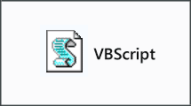



Progress so far
Notes:
There is much going on at the moment and much more to do for instance
We are upgrading from .NET1 to .NET4 so that the project can sit better on newer Oss
We are moving away from VBScript and .HTC Files (dynamic html behaviors) towards Javascript
We upgrading the GUI
And finally we are moving towards Octopus Deploy.

Slide 8

Challenges
Notes:
As many may assume, such big changes do come with their own problems
For instance, we’re ensuring that converting all VBScripts to JS, goes smoothly into the next version.
Fixing holes the upgrade may have introduced.
Ensuring the Octopus is used right due to the many parts of the project, etc
Apart from the technical issues there is also soft problems such as Domain Knowledge.
Despite all these problems, the project should be intime for the July deadline
Now, on to, new projects currently being developed for Onyx.

Slide 9

Tiered Pricing
Notes:
The Latest functionality addition to onyx is regards home loans.
Restrictions imposed by the RBNZ on home Loans as of October 2013.
Fewer home loans are available for customers with smaller deposits.

Slide 10

Rates / Margins / etc
Notes:
Customers with an LVR (Loan to Value Ratio) of 80+% will be charged a Low Equity Fee / margin on top of their existing rate.
Example:-
If you are buying a home for $100,000 and you have $20,000 for a deposit; the remaining $80,000 you need to borrow is 80 per cent of the home’s total value - making your LVR 80%.
The customer’s LVR is checked against pre-defined margin rules where he/she is charged according to their LVR.
The higher the LVR the higher the fee.

Slide 11

Notes:
Numbers
Project started on the February 18th.
124 days originally estimated for the project.
36 days ahead of schedule on development.

Slide 12

Challenges
Notes:
Challenges
Understanding the project specifications
Little structure in code

Slide 13

Notes:
Thank you for your patience.

